Slide 1
Traffic light vhdl
JAICHANGPARK

Slide 2
Internal
clock
Sequential
logic
State decoder
Output logic
led
Timing
circuit
Trigger logic

Slide 3
main
side

Slide 4
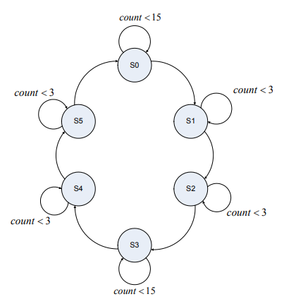
State | Main | side | delay
0 | G | R | 5
1 | Y | R | 1
2 | R | R | 1
3 | R | G | 5
4 | R | Y | 1
5 | R | R | 1

